Slide 1


A career in HR can take you further
Speaker name

Slide 2
We’re going to cover:
Who are the CIPD?
What is HR?
What roles there are within HR
Reasons to work in HR
Skills needed to work in HR
What you could earn
How to get into HR

Slide 3
Who are the CIPD?

Slide 4
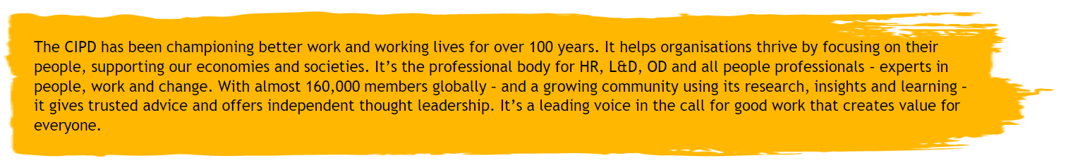
Who we are, why we are and how we are
Notes:
We’ve been around for over 100 years and we’ve amassed 140,000 members.
We believe work should be good for people whilst also being good for businesses (and by extension the economy and wider society)

Slide 5
What is ‘HR’?

Slide 6
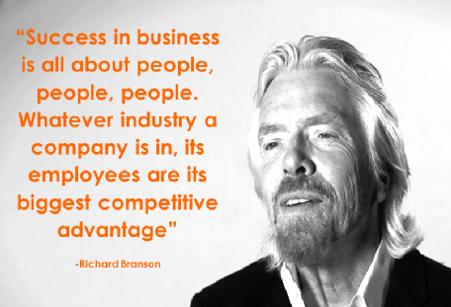
HR is about…
Making sure the business objectives are met through people whilst also making sure workers are ethically treated, looked after and engaged.
Notes:
People are the most important part of a business (trust us – Richard Branson agrees) so that makes HR a pretty important part of a business.
Think about the last time you did a project at school, and what made it work well or not so well. It’s likely that the main thing that changed the outcome was the people. You might have had people in that project you were really motivated to do it to a high standard or people might not have developed the skills to make the project great.
Well businesses are much the same. In order for a business to be the best it can be, it needs to bring the right people into the right jobs. Then those people need to be given opportunities to develop and progress, they need to have the right environment to work in and they need to feel engaged and positive about their work. These are all aspects of HR, but overall HR is about working with the people in an organisation to help the business as a whole.

Slide 7
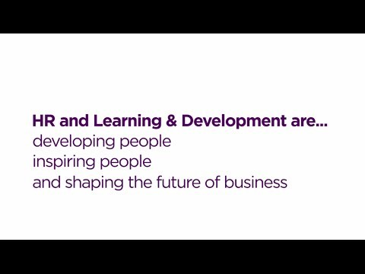
Hear from real HR professionals:
Visit the CIPD YouTube channel for more videos like this!

Slide 8
Hear from real HR professionals:
Visit the CIPD YouTube channel for more videos like this!

Slide 9
What roles can I do within HR?

Slide 10




Areas within HR
Organisation development
Employee engagement
Performance and reward
Employee relations
Learning and development
HR generalist
Recruitment and talent planning
Notes:
These are the main areas that you can work in within HR. Sometimes they’re called ‘specialisms’.
Every organisation is unique. Small companies may have one person doing bits of each of these roles, whilst big companies will have departments for each of these areas.
So let’s go through each area and see what’s involved…

Slide 11

Organisation development
Organisational development or ‘OD’ is to do with improving an organisations effectiveness by taking a look at its:
Processes (how things are done)
Structure (how a business is organised)
Culture (how people behave in organisations)
Then creating a plan for how to improve them.
Notes:
Organisational development or ‘OD’ for short is…you guessed it…about developing the organisation to be the best it can be.
The way people who work in OD do this is by:
Working with the people who lead the company and building a vision of where the company should be.
Doing an analysis of the organisation and identify areas for improvement.
Developing programmes to address these areas e.g. training
Consulting with employees to make sure they’re aware of the changes
Manging the programme to completion
It can be a tough job because people are often threatened by change, but also a rewarding job because it can save a failing company.

Slide 12

Employee engagement
Businesses perform better when their employees feel connected to the organisation and happy about their roles.
Employee engagement professionals try to measure this set of feelings, then figure out ways to improve or nurture them.
Notes:
Employee engagement is all about making sure employees are engaged.
Engaged employees are productive, helpful and happy.
People who work in this area need to find a way of quantifying the levels of engagement. They might send out surveys or talk to people, then once they know the ‘mood’ of the organisation, think of different ways to make it even better.

Slide 13

Performance and reward
Performance and reward professionals help decide how much people in an organisation should be paid and rewarded based on their performance.
Notes:
If you’re more analytical and like working with data, performance and reward might be for you. It can be pretty complicated working out how much everyone should get paid – there lots to consider. Hear from Rajinder to find out more: play video.

Slide 14
Employee relations
Employee relations is about managing relationships with an organisation e.g. between managers and workers.
It can involve:
working closely with trade unions
mediating conflict
helping to create trust through transparent communication.

Slide 15
L&D
Learning and Development or ‘L&D’ is about helping employees to learn and develop to reach their potential.
L&D professionals:
Identify knowledge or skill gaps – for individuals or teams
Choose the right ways to fill the gaps e.g. training, mentoring
Evaluate the success of the methods chosen
Notes:
As we heard in the first clip, this is about training and developing people within an organisation.
It’s a little bit like teaching, but there’s not really a curriculum. You have to figure out what the business needs the employees to know and do, then help the employees reach their potential.

Slide 16
Recruitment and talent planning
Recruitment is about attracting and bringing ‘talent’ (people with an attractive set of skills and/or knowledge) into the organisation to fill short or long term business needs.
For example, if a business decided that they needed to attract more online customers, they may try to bring someone in with a talent for digital marketing.
Notes:
There’s a bunch of talented people out there, and businesses have to compete to make sure they get the best people.
Recruitment is about persuading them to come to your company through campaigns and job adverts, and then taking them through the process of being hired, from interviewing all the way to telling them they’ve got the job!

Slide 17

HR generalist
HR generalists do bits of all of the specialist areas, so they experience a wide variety of different tasks.
Notes:
The clue is in the name. HR generalists focus on more general activities. This can touch on a lot of the specialisms, but typically they’ll work on branching out into the organisation, connecting the dots and advising the business on HR issues.
You can start in a HR generalist role, then work your way to the top through other generalist positions, or branch out into a specialist role.

Slide 18
Why should I work in HR?

Slide 19
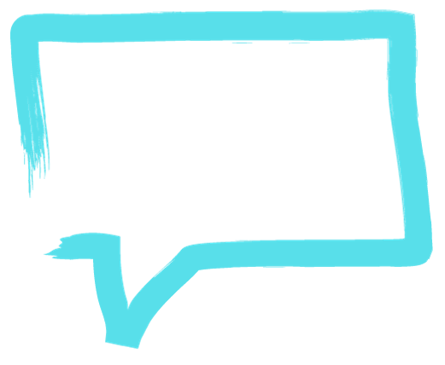
Five reasons to work in HR
HR gives you a passport to get right across any organisation, and to move between industries and sectors.’
Tim Pointer, Head of HR
Work anywhere!
Variety of work
It’s a growing industry
Make a difference to peoples lives
Make an impact on the business
The best thing about my job is working in a fast-paced environment, there’s always lots going on, every day is different.’
Luke Smith, HR Assistant
Notes:
1) HR gives you the opportunity to work in every sector, from media to engineering and from banks to charities as most businesses need an HR professional to help support their people management. And HR professionals work globally so the world is your oyster!
2) A career in HR offers long-term options and a huge variety of roles. You could be involved in recruiting or training staff one day, or helping your company decide how staff should be rewarded the next. There are even roles which focus on law, protecting the employment rights of employees at work.
3) The HR profession has been experiencing steady growth and this is expected to continue for the next 5-10 years.
4) A great HR professional can have a profoundly positive impact on people just by clocking in each day. The daily duties of the job make employee welfare and happiness a matter of professional responsibility.
5) As we’ve discussed, HR is crucial to making sure the business can get to where it needs to, so you would work very closely alongside the strategy of the business.

Slide 20
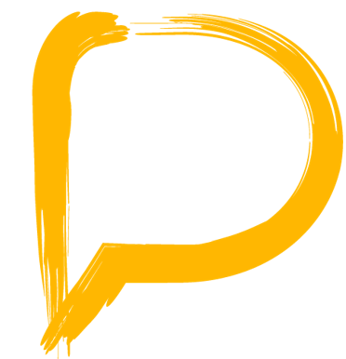
What skills do I need?

Slide 21
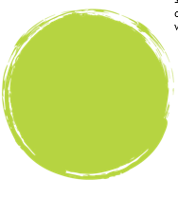
Top 5 skills of great HR professionals
Interested about how the business works as well as its products, services and customers
Gathering and analysing information to make the right decision
Ability to communicate and influence all kinds of different people
Guided by a sense of moral fairness and willing to challenge unethical decisions
Ability to work through problems with patience and determination
Decisive Thinking
Skilled Influencer
Ethical integrity
Problem solver
Curious
Notes:
Curious – HR professionals have to know about business in general but also all about their own organisations as they have to make decisions with an understanding of what is going to be affected.
Decisive thinker – the HR industry is becoming increasingly driven by data, so its important that you know how to manage that and use it to make good decisions
Skilled influencer – in business you have to sell your ideas, and HR is no different.
Ethical integrity – If you work in HR, you need to lead by example. You should act with integrity and impartiality and have the courage to defend your views
Problem solver – there’s no doubt you’ll encounter plenty of issues, and because you’re dealing with people, they’ll never be clear cut. You need patience to work through challenges and the determination to push ahead
Remember – these can all be learned behaviours

Slide 22
What could I earn?

Slide 23
HR salary averages (UK)
HR Director
Average of £120,263
Up to £222,487
Salary can be influenced by lots of different things, such as:
Sector
Size of organisation
Region
Specialism
Head of HR department
Average of £87,029 Up to £130,543
HR Manager
Average of £63,439 Up to £88,180
HR graduate
Average of £26,332
Up to £34,232
Notes:
Source: Croner salary data 2023
On the right are UK averages for the different levels in HR, however these can vary quite dramatically.
HR professionals in the private sector tend to earn more than those in the public or third sector
Size of organisation – HR professionals in large organisations earn up to a quarter more than those in small organisations
Region – HR professionals in London earn about 3.1% more than the average, whilst HR professionals in the north east earn 10% less than the average
Specialism – Reward managers earn the most out of all of the specialisms

Slide 24
How do I get into HR?

Slide 25
There are lots of different ways to get into HR
Depending on how you like to learn, you can:
Do an HR apprenticeship
Study an accredited HR qualification
Do a degree
Do a graduate training scheme (after your degree)
Notes:
Often students ask us which GCSEs and A levels they should do so this is a good time to mention that nothing will limit them at this stage, but if they’re interested in HR then they could study business studies, psychology, sociology or economics as a lot of the theory behind HR practices comes from behavioural/social sciences and how this applies to organisations.

Slide 26
HR apprenticeships
We’ve been working with M&S, RBS, the NHS, McDonalds, HSBC and the Cabinet Office to create new apprenticeship at level 3 and 5 – starting in September so keep a look out!
The Higher apprenticeship in Human Resource Management will give you a chance to:
Earn while you learn
Study towards a level 5 qualification (equivalent to second year of University)
Become an associate member of the CIPD
Find out more and look for apprenticeships near you at www.apprenticeships.org.uk
Notes:
OR…if you’d rather do something more general, the Business and Administration apprenticeship includes optional modules that cover HR activities.

Slide 27
Accredited HR qualifications
Choose how you want to study
      260 study providers to choose from
      Study full time, part time, online or through supported distance learning
Gain professional membership
      Become a member of the CIPD
      Get access to a range of career support
Choose from a range of different courses
      Level 3 Foundation (equivalent to A levels)
      Level 5 Intermediate (equivalent to a foundation degree)
      Level 7 Advanced (equivalent to a postgraduate degree)
Notes:
We have 260 study centres, from college and universities to private training companies. They all deliver courses in different ways. You can opt for traditional forms of study i.e. full time or part time, or you can choose to study entirely online. You could also choose a supported distance learning course. This is where most of your study is done online, but you have a workshop every few months to attend.
Anyone over the age of 18 can study for a CIPD qualification, and when you’ve finished, you get to become an associate member of the cipd. You’ll look more attractive to employers, plus you can access career support and resources. Currently we offer a mentor matching scheme and free career workshops to help you with CV and interviewing skills.
Dependent on your experience and qualifications, you can apply for one of 3 qualification levels.
If you get asked how much they cost or how long they take, this is all dependant on the study provider and the form of study they choose. If they study a certificate this will be cheaper and less time consuming as they won’t study as many modules as the diploma, if they want to know what modules they can take, this is all on our website but I doubt they’ll ask.
At each level there are core modules that cover the basics and then optional modules, so you can choose to study the areas you’re more interested in e.g. recruitment
Employers sometimes pay you through one of these courses if you’re already working in HR.

Slide 28
Degrees
Human Resources degree – look for CIPD approved!
Combined degree e.g. business management and human resources
Psychology
Sociology
Economics
Notes:
If you study a CIPD approved Human Resources course you will gain Student membership of the CIPD and access to a range of career support and membership benefits. Other degrees that may be useful are combined degrees, such a Business Management and Human Resources, or a social science degree such as Psychology or Sociology. An in-depth understanding of people will prove invaluable in a HR setting

Slide 29
Graduate training scheme
Grad schemes are a great way to get into a profession once you’ve finished your degree.
Grad schemes are offered by :
Balfour Beatty;
BP;
Civil Service;
GlaxoSmithKline (GSK);
KPMG;
National Health Service (NHS);
Rolls-Royce;
Nestle;
Unilever;
Tesco.
And lots more…
Notes:
These are sometimes quite general and you can get exposure to different parts of a business, OR you can join a programme that’s focused specifically on HR.

Slide 30
Resources for more information
For more information about:
CIPD Career pages
https://www.cipd.org/uk/the-people-profession/careers/
Careers in HR
www.plotr.co.uk/careers/worlds/hr-world/
Apprenticeships
https://www.gov.uk/topic/further-education-skills/apprenticeships
CIPD qualifications
www.cipd.co.uk/qualifications
Routes into HR
https://www.cipd.org/uk/the-people-profession/careers/routes-into-profession/
Notes:
Short video

Slide 31
Questions?
Email careersupport@cipd.co.uk
More information: https://www.cipd.co.uk/careers

