Slide 1
CIPD webinar:
Navigating an economic downturn – and looking after your people
08 December 2022

Slide 2
Welcome
Jill Miller, Senior Policy Advisor - Diversity and Inclusion, CIPD

Slide 3
Today’s speakers
Rachel Suff
Senior Policy Advisor – Employee Relations, CIPD
Dr Madeleine Stevens
Senior Lecturer in HRM, Liverpool John Moores University
Katie Obi
Chief People Officer,
Beamery
Alan Lewis
Partner,
Constantine Law

Slide 4










#StrongerWithCIPD
Covid-19 resources
NEW Well-being helpline
Employment Law helpline
Communities and branches
People Management
Knowledge and content
Free learning
Careers support
Professional creditability
Financial support
cipd.co.uk/memberbenefits

Slide 5


Wellbeing Resources
We’ve partnered with Health Assured to support members mental health and wellbeing
Unlimited free 24/7 confidential telephone helpline, online portal & Health e-Hub app
The resource provides:
  Legal information
  Debt and financial information
  Manager consultancy and support
  Information on work and home issues
  Factsheets, advice, information and self-help tools
  Links to specialist support organisations
  A resources area with; programmes, videos, webinars, medical information and mini health checks.
Notes:
In recognition of the increased pressure and personal challenges many of you might currently be facing we’re launched a new Well-being helpline for the UK and Ireland. Calls are FREE and confidential. Phonelines are open 24 hours a day, 7 days a week, 365 days a year.
Work through your problems with a qualified therapist accredited by the British Association for Counselling and Psychotherapy (BACP).
Legal information services - support on a range of issues including personal, financial and legal matters.
Debt and financial information - support for issues such as debt, investments, pensions, managing money, negotiating with creditors.
Manager consultancy and support - at helping people managers to support their teams effectively.
Plus there are online resources and a well-being app you can download.

Slide 6
Rachel Suff
Senior Employee Relations Adviser, CIPD
Twitter: @RSuff

Slide 7

Volatility
Uncertainty
Complexity
Ambiguity

Slide 8
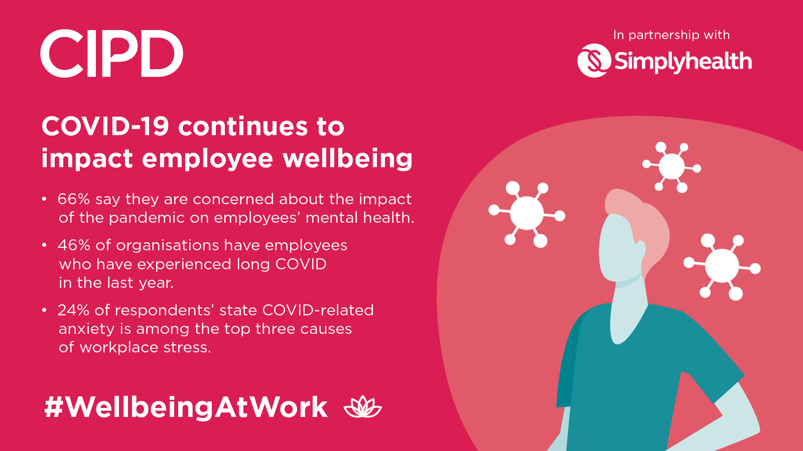

Slide 9
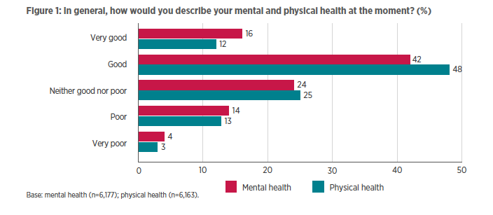
Health and wellbeing: the employee view
[CIPD UKWL survey 2022]

Slide 10

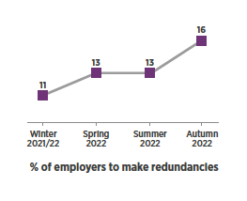

Redundancy intentions
Redundancy intentions remain low but are increasing – 16% of employers are planning to make redundancies in the three months to December 2022 (up from 13% last quarter)

Slide 11
Alternatives to redundancy
Temporary lay offs
Recruitment freezes
Redeployment
Wage flexibility – eg pay freezes, pay cuts, bonus cuts
New or more flexible working arrangements; short-time working
Terminating agency/temporary worker contracts
Reductions in training budgets

Slide 12

Managing change and redundancy in the current climate

Slide 13

Ensuring compassion and supporting people’s health and wellbeing
Treat people with dignity, respect and kindness – this can make a big difference to how they cope
Communicate regularly – be clear, sincere and transparent
Provide ongoing health and wellbeing support – eg EAP, counselling, signposting to wellbeing charities etc
Be mindful of the potential impact on the wider workforce – build morale and help people look to the future
Train and support line managers to have empathetic conversations and listen to concerns

Slide 14
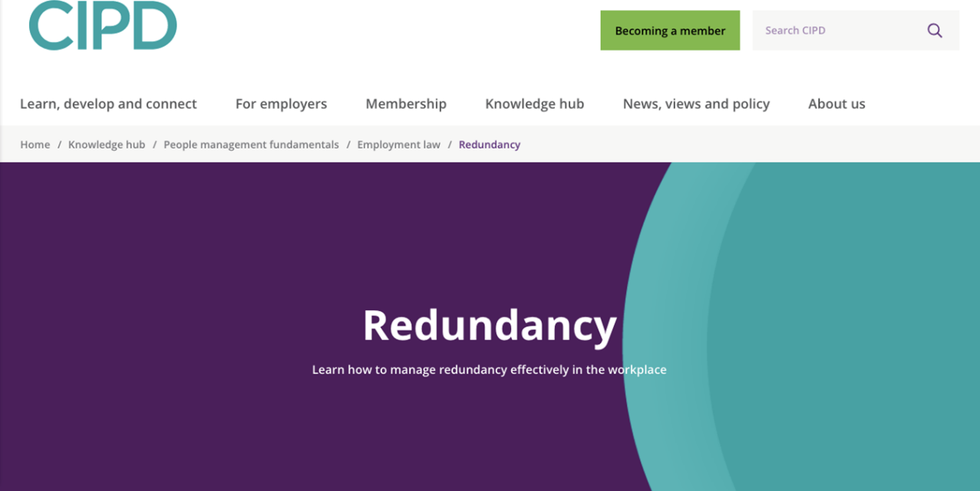

Slide 15



Redundancy implications
Dr. Madeleine Stevens
8 December 2022

Slide 16
What is a redundancy?
Redundancy, as demarcated in legalistic interpretation Employment Rights Act, 1996, section 139 :1 is defined as a reason for dismissal of an employee attributable wholly or mainly to:
(a) the fact that the employer has ceased, or intends to cease
(i) to carry on the business for the purposes of which the employee was employed by him, or
(ii) to carry on that business in the place where the employee was so employed, or
(b) the fact that the requirements of that business -
(i) for employees to carry out work of a particular kind, or
(ii) for employees to carry out work of a particular kind in the place where the employee was employed by the employer have ceased or diminished or are expected to cease or diminish.

Slide 17

Why implement redundancies?
Change management strategy used since the 1970’s
(Gandolfi, 2009; Williams, 2004)
Drivers: immediate reduction of costs
Increased levels of:
Efficiency
Productivity
Profitability
Competitiveness
(Allen et al., 2001; Cameron, 1994; Gervais, 2004; Nelson & Burke, 1998)

Slide 18
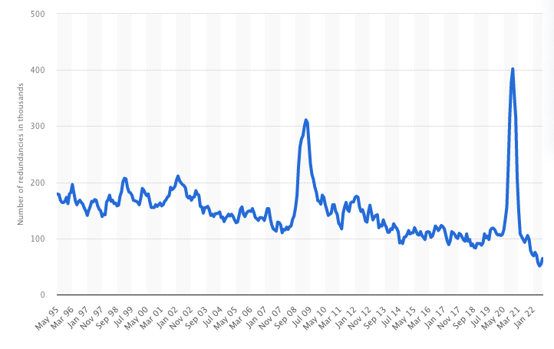
Average number of people made redundant in the UK - May 95 – July 22
https://www.statista.com/statistics/1172074/uk-monthly-redundancies/

Slide 19
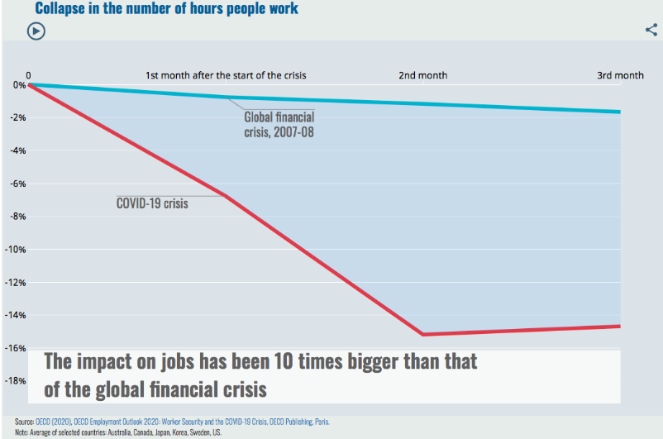
Impact of COVID-19
https://www.oecd.org/employment-outlook/2020/
Notes:
https://www.ilo.org/wcmsp5/groups/public/@dgreports/@dcomm/documents/briefingnote/wcms_767028.pdf

Slide 20
Groups impacted by redundancies
Victims
The individuals that exit the organisation
Survivors
The individuals that remain in the company during and after the programme.
Semi-survivors
Employees that were first victims, then rehired, becoming survivors.
Redundancy envoys
The individuals entrusted with the implementation of redundancies.
Stevens, 2022

Slide 21
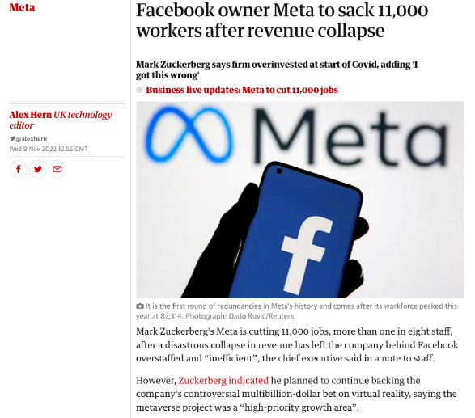
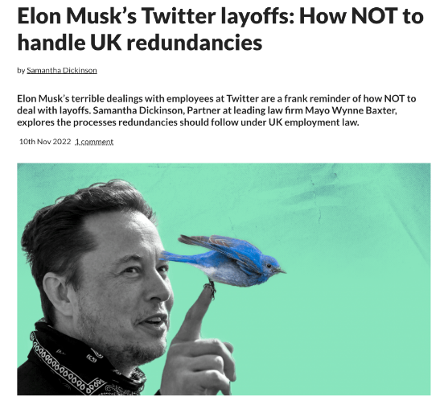

New wave of redundancies

Slide 22
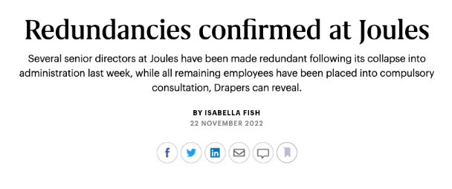
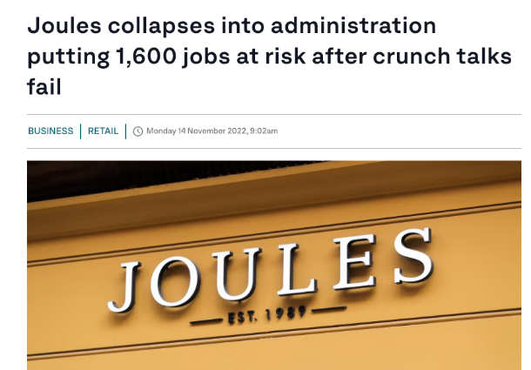


Slide 23
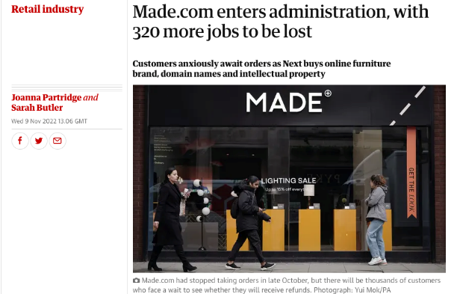
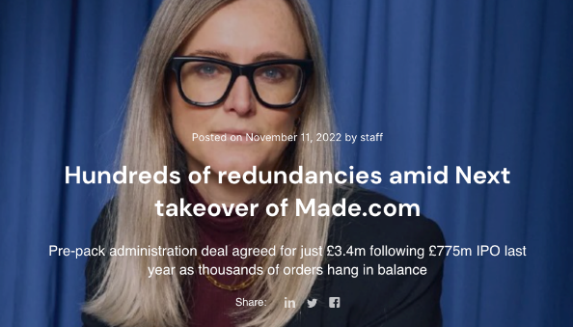

Slide 24
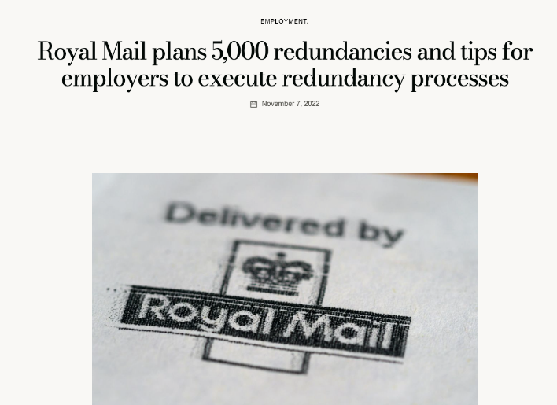

Slide 25
Symptoms of survivor syndrome
Increased workload
Survivor guilt
Survivor envy: feelings of envy towards victims
Anger
Relief
Job insecurity
Managing higher levels of stress, absenteeism, mistrust
Working in an environment with possible decreased work quality, morale, productivity
Decreased employee involvement
Decreased trust towards management
Depression
Fear and anxiety

Slide 26


What is the impact on redundancy envoys?
Fear
Frustration
Guilt
Anger
Disappointment
Embarrassment
Shock
Envy
Blame
A ‘rollercoaster of emotions’
Notes:
Redundancy envoys themselves rarely admit to experiencing suffering during redundancies, as arguably this could be regarded as a weakness (Torres, 2011). He argues that redundancy envoys suffering during the process of redundancies is ignored by specialists in the field on the basis of their theoretical preconception that because the employer is dominant, they are unable to experience the suffering and thus their suffering is unheard. The suffering of redundancy envoys’ is however very real, despite coning across as being deceptive due to redundancy envoys appearing insensitive to employees, due to their own fear of rejection (Moran, 2001). The role of the redundancy envoy during redundancies is unique, underestimated and extremely stressful, yet the importance of their wellbeing is of utmost importance as these are the individuals who need to lead the organisation through its transition into the future.

Slide 27

Importance of your role
The importance of the role of the redundancy envoy and the significant impact they can have on the success of a workforce reduction programme is critical based on the following dimensions:
Redundancy envoys have different roles and experiences
They can positively influence victims and survivors
This can positively impact the success of the business
Notes:
Redundancy envoys themselves rarely admit to experiencing suffering during redundancies, as arguably this could be regarded as a weakness (Torres, 2011). He argues that redundancy envoys suffering during the process of redundancies is ignored by specialists in the field on the basis of their theoretical preconception that because the employer is dominant, they are unable to experience the suffering and thus their suffering is unheard. The suffering of redundancy envoys’ is however very real, despite coning across as being deceptive due to redundancy envoys appearing insensitive to employees, due to their own fear of rejection (Moran, 2001). The role of the redundancy envoy during redundancies is unique, underestimated and extremely stressful, yet the importance of their wellbeing is of utmost importance as these are the individuals who need to lead the organisation through its transition into the future.

Slide 28

Focus on support you can give
Keep calm
Focus employees on moving on, rather than looking back
Encourage employees at risk:
  see redundancy as an opportunity for change
  to take stock of their situation and look at options
  talk to friends and family
  Get advice from professional advisers / support services

Slide 29

Support for survivors
Training and development
All the same workshops that victims are offered
Counselling sessions
Support on how to cope with the increased workload
Clear task and job descriptions
Reward and recognition
Regular engagement
Clear vision
Notes:
Don’t forget to also focus our ‘survivors’
Survivor syndrome is experienced by survivors of the redundancy programme as well as by redundancy envoys. Survivor syndrome includes feelings of guilt, where for example colleagues feel guilty that they kept their jobs, when they may believe that employees that were more able or who needed the finance more, should have stayed in the role. Survivor syndrome also include feelings of job insecurity, fear and anger towards the organotin for being put in this position, essentially systematic from a perceived breach of their psychological contract. Others experience a feeling of relief that they have kept their jobs. High levels of mistrust is often experienced between colleagues, but also towards the organisation.

Slide 30

How do we support each other?
Strong partnership between HR and management
Training on the legal aspects of redundancy law
Training on how to deal with giving bad news and emotional reactions
Support groups
Counselling sessions
Redundancy veterans
Limit proximity to victims
Planning
Leadership

Slide 31
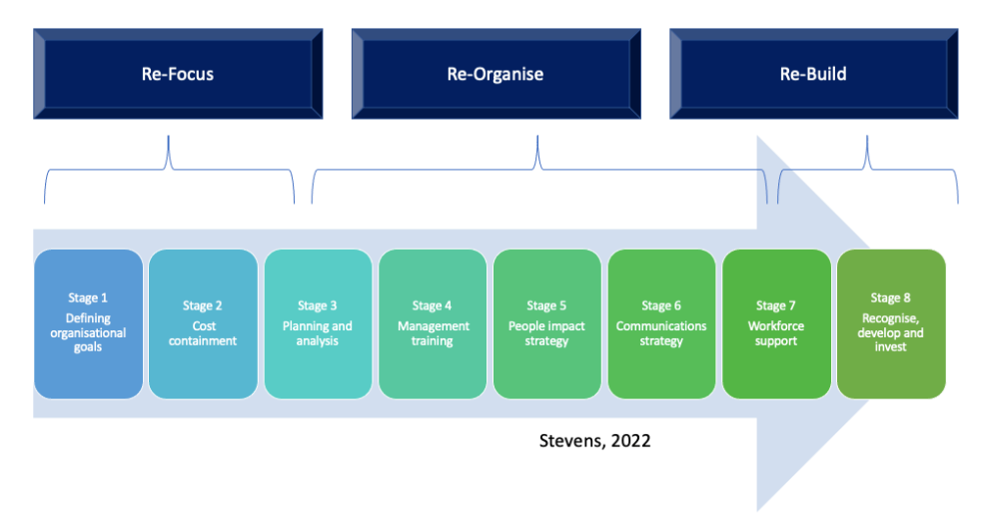
8 step Strategic Redundancy Implementation model

Slide 32
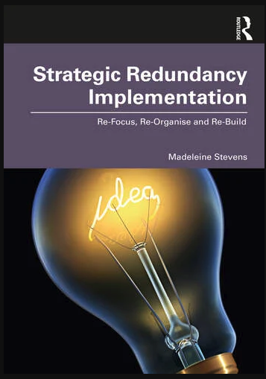

Slide 33
Katie Obi
Chief People Officer, Beamery

Slide 34




Slide 35

Redundancies –the key points (1/2)
Is it redundancy? Closure of business; closure of place of work; reduced need for e/ees to carry out work of a particular kind.
Collective redundancy? 30 or 45- day consultation period (TUs or elected ERs) – HR1 to Sec of State. Criminal offence (?)
Consultation – formative stage; adequate information; adequate time; conscientious consideration of the response to consultation.
Pools? Caution – interchangeable skills

Slide 36

Redundancies –the key points (2/2)
Bumping
Selection criteria and scoring OR selection interviews
Maternity - special case
Redundancy pay
Suitable alternative job + unreasonably refused
Unfair dismissal

Slide 37
Questions
Please submit your questions for:
  Rachel Suff, Senior Policy Advisor – employee relations, CIPD
  Madeleine Stevens, Senior Lecturer in HRM, Liverpool John Moores University
  Katie Obi, Chief People Officer, Beamery
  Alan Lewis, Partner, Constantine Law
Please use the Q&A function to submit your questions

Slide 38
#StrongerWithCIPD
Covid-19 resources
NEW Well-being helpline
Employment Law helpline
Communities and branches
People Management
Knowledge and content
Free learning
Careers support
Professional creditability
Financial support
cipd.co.uk/memberbenefits

Slide 39
Wellbeing Resources
We’ve partnered with Health Assured to support members mental health and wellbeing
Unlimited free 24/7 confidential telephone helpline, online portal & Health e-Hub app
The resource provides:
  Legal information
  Debt and financial information
  Manager consultancy and support
  Information on work and home issues
  Factsheets, advice, information and self-help tools
  Links to specialist support organisations
  A resources area with; programmes, videos, webinars, medical information and mini health checks.
Notes:
In recognition of the increased pressure and personal challenges many of you might currently be facing we’re launched a new Well-being helpline for the UK and Ireland. Calls are FREE and confidential. Phonelines are open 24 hours a day, 7 days a week, 365 days a year.
Work through your problems with a qualified therapist accredited by the British Association for Counselling and Psychotherapy (BACP).
Legal information services - support on a range of issues including personal, financial and legal matters.
Debt and financial information - support for issues such as debt, investments, pensions, managing money, negotiating with creditors.
Manager consultancy and support - at helping people managers to support their teams effectively.
Plus there are online resources and a well-being app you can download.

