Slide 1
CIPD Coronavirus webinar series
Understanding the impact of long COVID
27 September 2021

Slide 2
Welcome
Charlotte Chedeville, Senior Programme and Project Manager, CIPD Middle East

Slide 3
Today’s speakers
Charlotte Chedeville
Senior Programme and Project Manager,
CIPD Middle East
Rachel Suff
Senior Employee Relations Adviser,
CIPD
Steve Boorman
Director of Employee Health, Empactis
Dr Jo Yarker
Director of Affinity Health at Work and Senior Lecturer, Birbeck University of London
Lesley Macniven
Chair of the UK Long COVID Support Employment Working Group
Matthew Reymes-Cole
Legal Manager, Croner

Slide 4










#StrongerWithCIPD
Covid-19 resources
NEW Well-being helpline
Employment Law helpline
Communities and branches
People Management
Knowledge and content
Free learning
Careers support
Professional creditability
Financial support
cipd.co.uk/memberbenefits

Slide 5
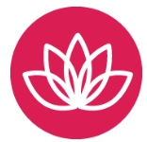
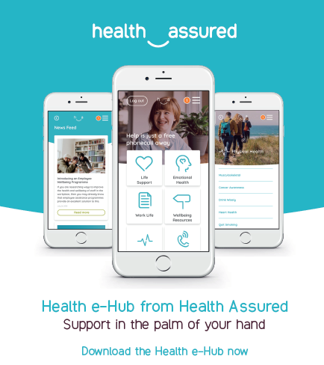
*New* Wellbeing Resources
We’ve partnered with Health Assured to support members mental health and wellbeing
Unlimited free 24/7 confidential telephone helpline, online portal & Health e-Hub app
The resource provides:
  Legal information
  Debt and financial information
  Manager consultancy and support
  Information on work and home issues
  Factsheets, advice, information and self-help tools
  Links to specialist support organisations
  A resources area with; programmes, videos, webinars, medical information and mini health checks.

Slide 6
What are the key considerations for HR?
Rachel Suff, Senior Employee Relations Adviser, CIPD
@RSuff

Slide 7
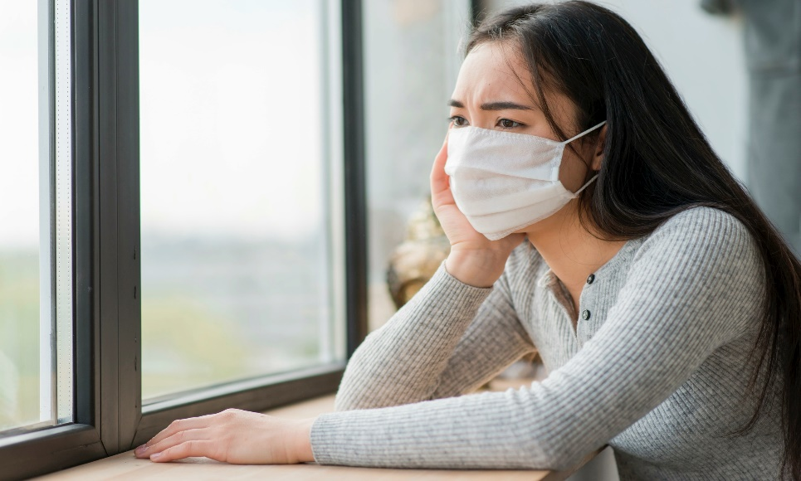
Understanding ‘Long COVID’ and its impact
Real risk of job loss for people with post-COVID syndrome if not properly supported
Highly unpredictable nature of symptoms means policies and support need to be very flexible and responsive, based on individual need
HR/managers need to work closely with health professionals, eg Occupational Health, where possible
Compassion and understanding are key
‘…unusual patterns: relapses, phases with new, sometimes bizarre symptoms’

Slide 8
Good people management is key to ongoing and flexible support
Educated about Long COVID
Work with health professionals,
eg OH
Compassionate and sensitive 121s
Supportive policies and practical adjustments
Ongoing and flexible support, NB RTW

Slide 9
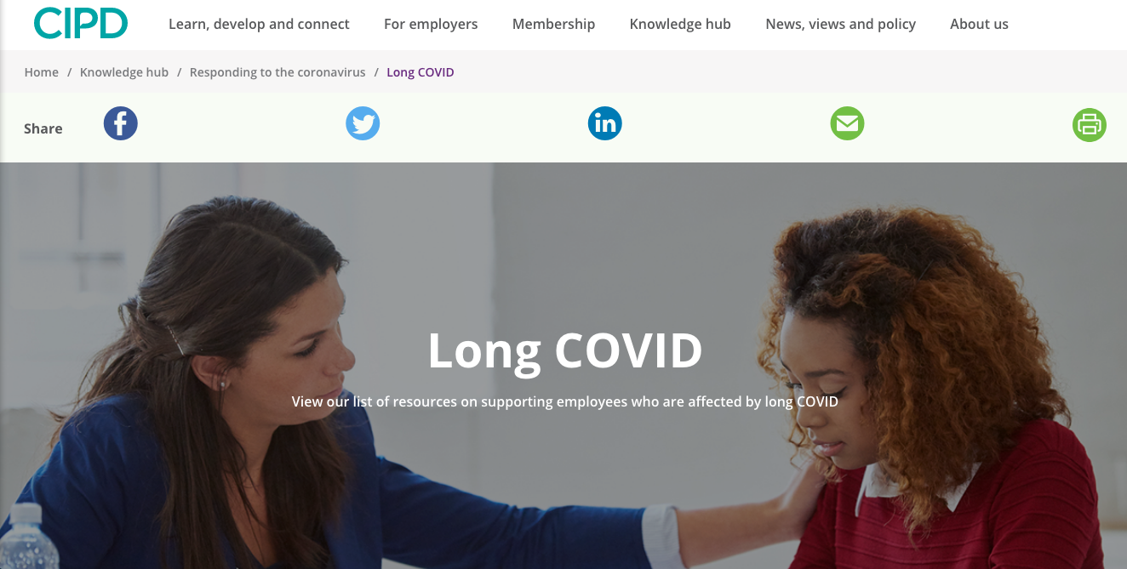
FAQs
Guides
Forums
Webinars
cipd.co.uk/knowledge/coronavirus/long-covid

Slide 10
Dr Joanna Yarker, Affinity Health at Work
jo@affinityhealthatwork.com

Slide 11
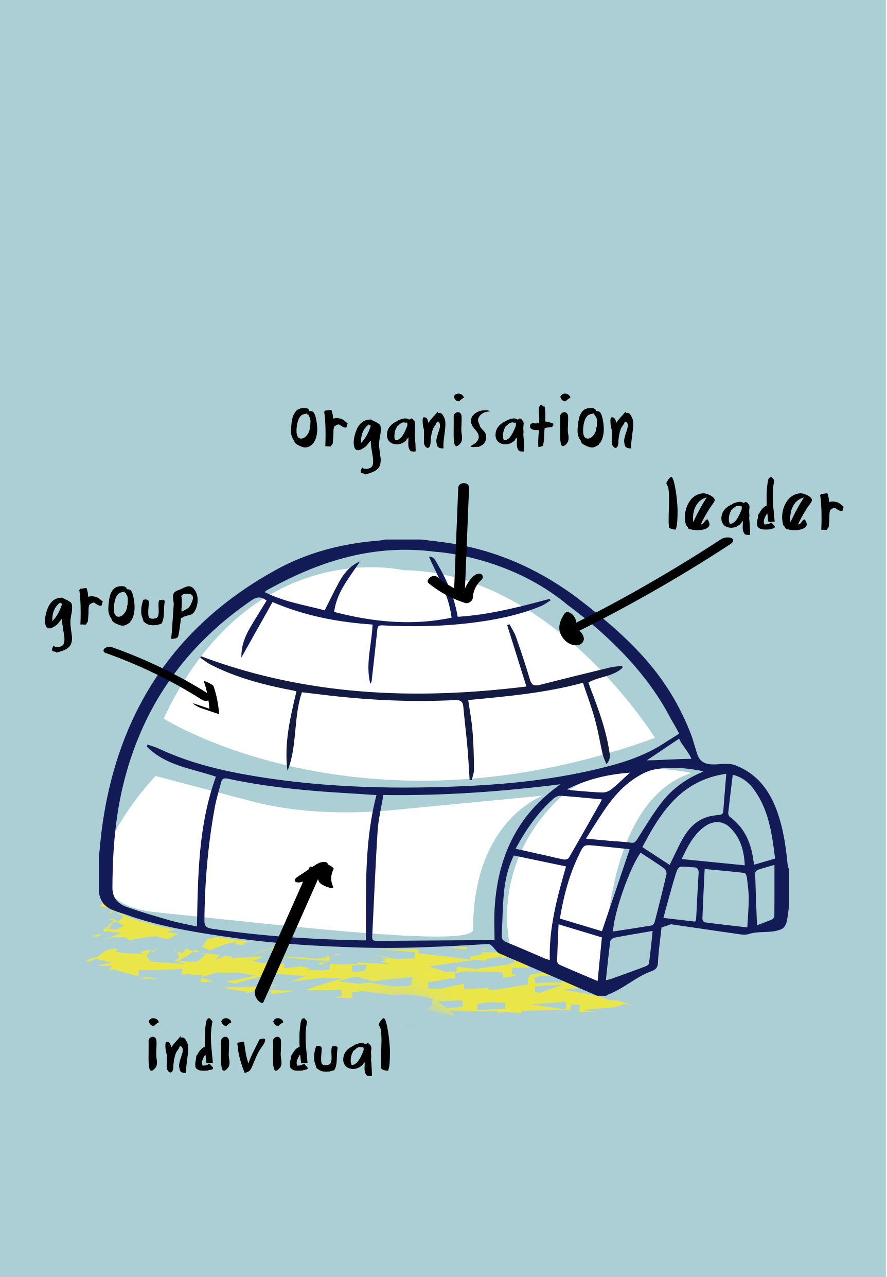


Working with Long Covid - Using the IGLOO Model to help people return to, and stay at, work following Long Covid absence
Insert company logo
Notes:
Long Covid sickness absence and work ability
Introduction to the IGLOo approach
Building your IGLOo
Individual level
Group level
Line manager level
Organisational level
Things to think about
Signposting resources

Slide 12
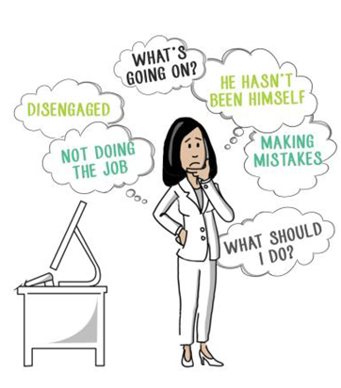

Sickness absence due to Long Covid
TOO MANY
Over 2 million adults in England may have had Long Covid (Whitaker et al., 2021)
Lunt et al. (2021) found that less than 15% of employees experiencing long covid had returned to work fully
FOR TOO LONG
The longer people stay off, the less likely they are to return
WITH TOO LITTLE SUPPORT
Managers are unsure of what to do or say, they do not know how to make adjustments
Employees are unsure of what to say, or what to do

Slide 13
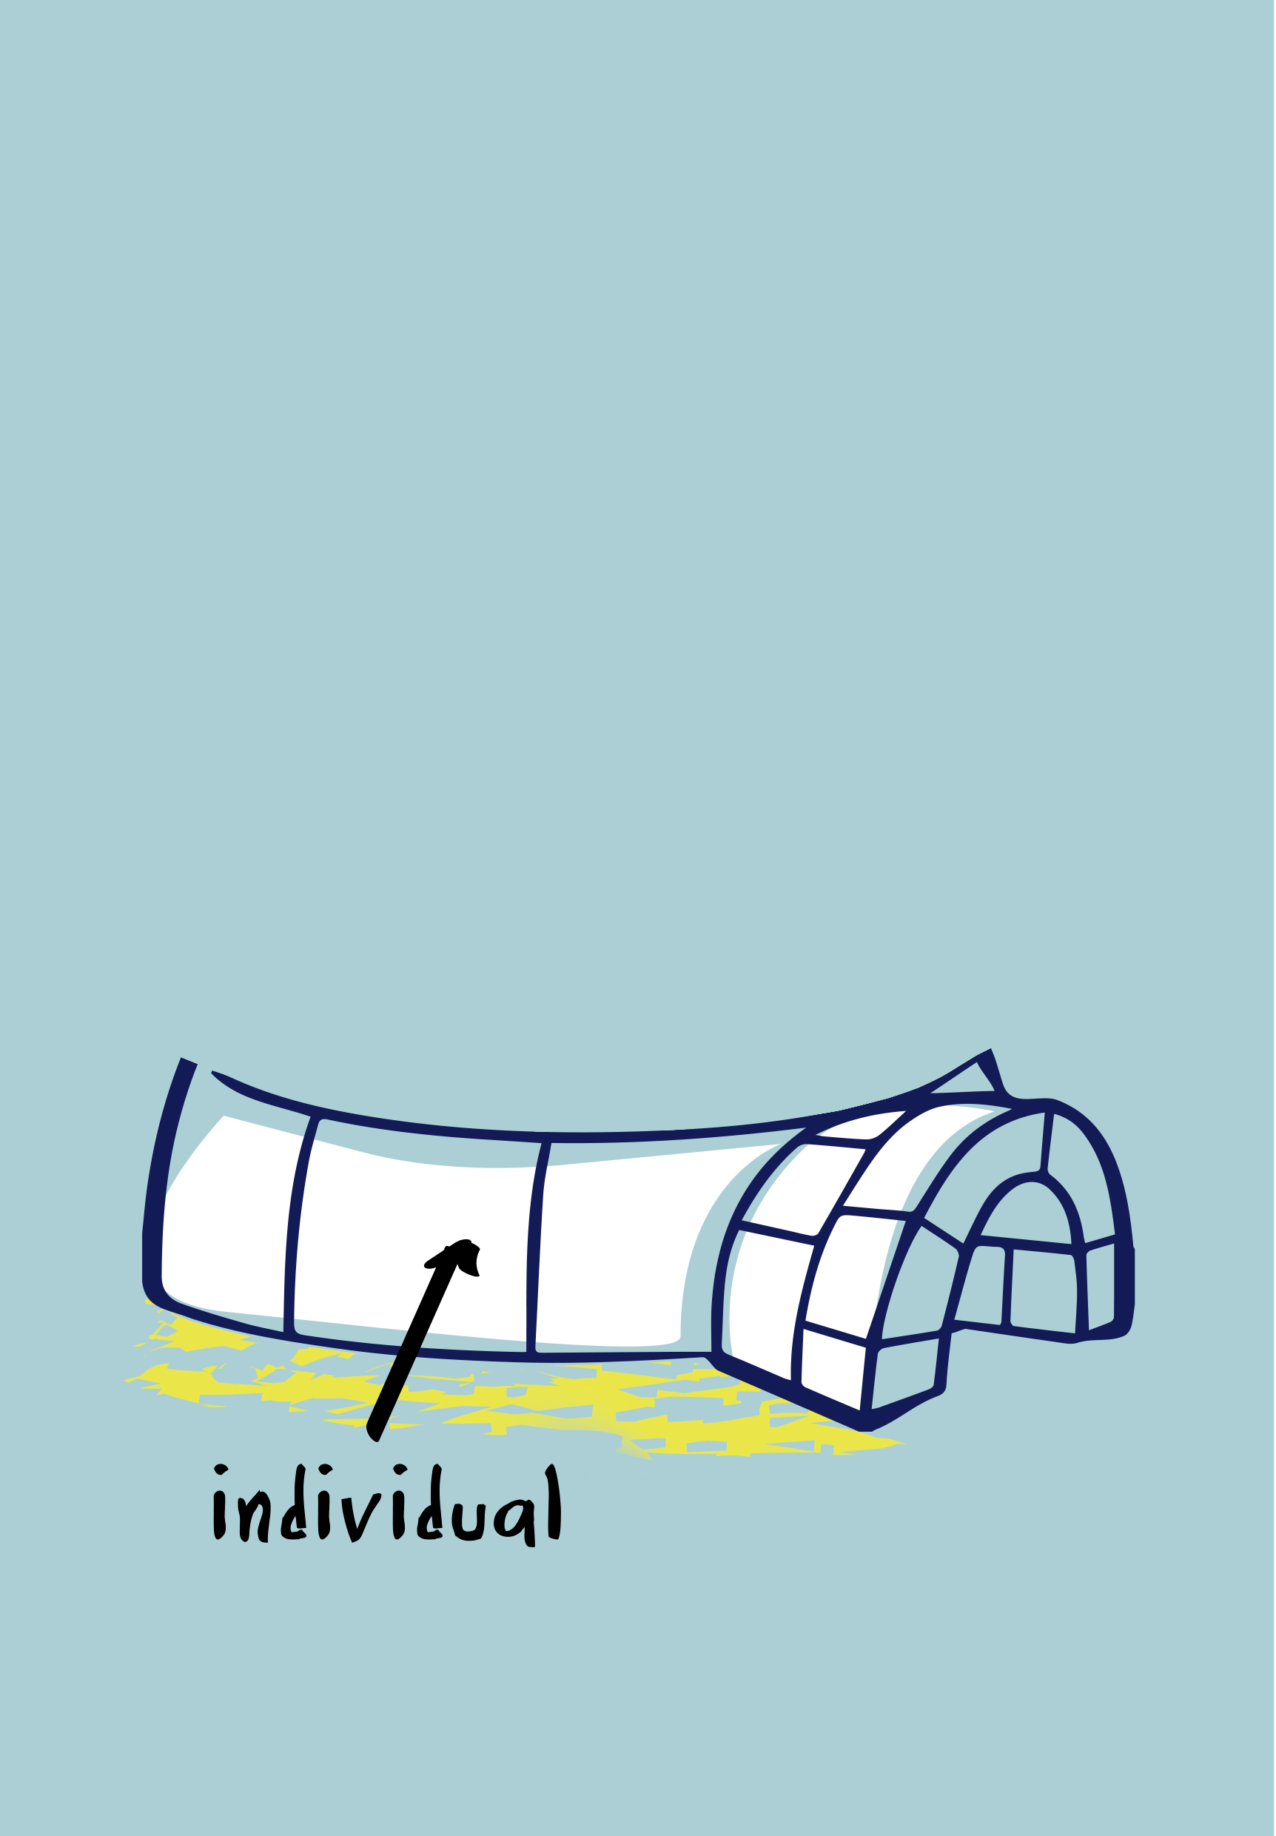

Individual level
Work
Coming to terms with reduced work functioning and not being able to push through like before
Resetting career expectations (for the time being)
Accepting that they cannot work at times
Being open about work functionality - while hard it is necessary
Non-work
Prioritise self-care
Accepting slow pace of recovery - two steps forward and one step back
……..
Dr Joanna Yarker | E: jo@affinityhealthatwork.com | www.affinityhealthatwork.co.uk
Notes:
NOTES FROM MENTAL HEALTH PRESENTATION
Create structure in your working day
Prioritise according to importance vs urgency
Minimise distractions
Focus on outputs vs inputs
Seek flow experiences
Acknowledge mastery
Self-care – act, self compassion, exercise, nutrition..

Slide 14
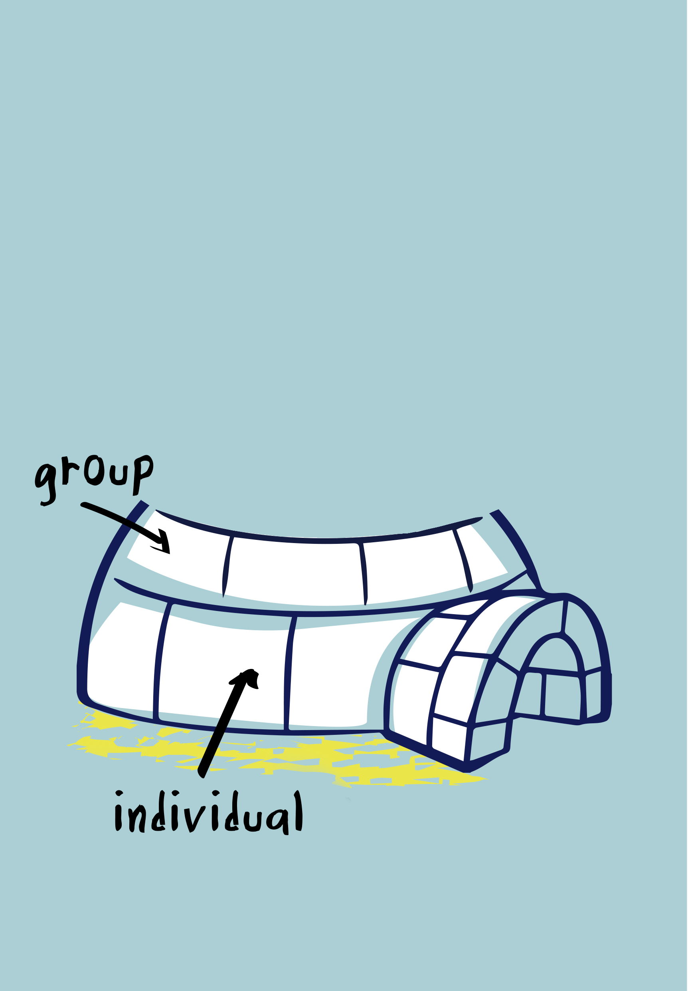
Group level
Work
Instrumental support – stepping in to help with tasks
Accepting a slower pace of work
.......
Non-work
Emotional social support
Outside work activities to help with recouperation
……..
Dr Joanna Yarker | E: jo@affinityhealthatwork.com | www.affinityhealthatwork.co.uk

Slide 15
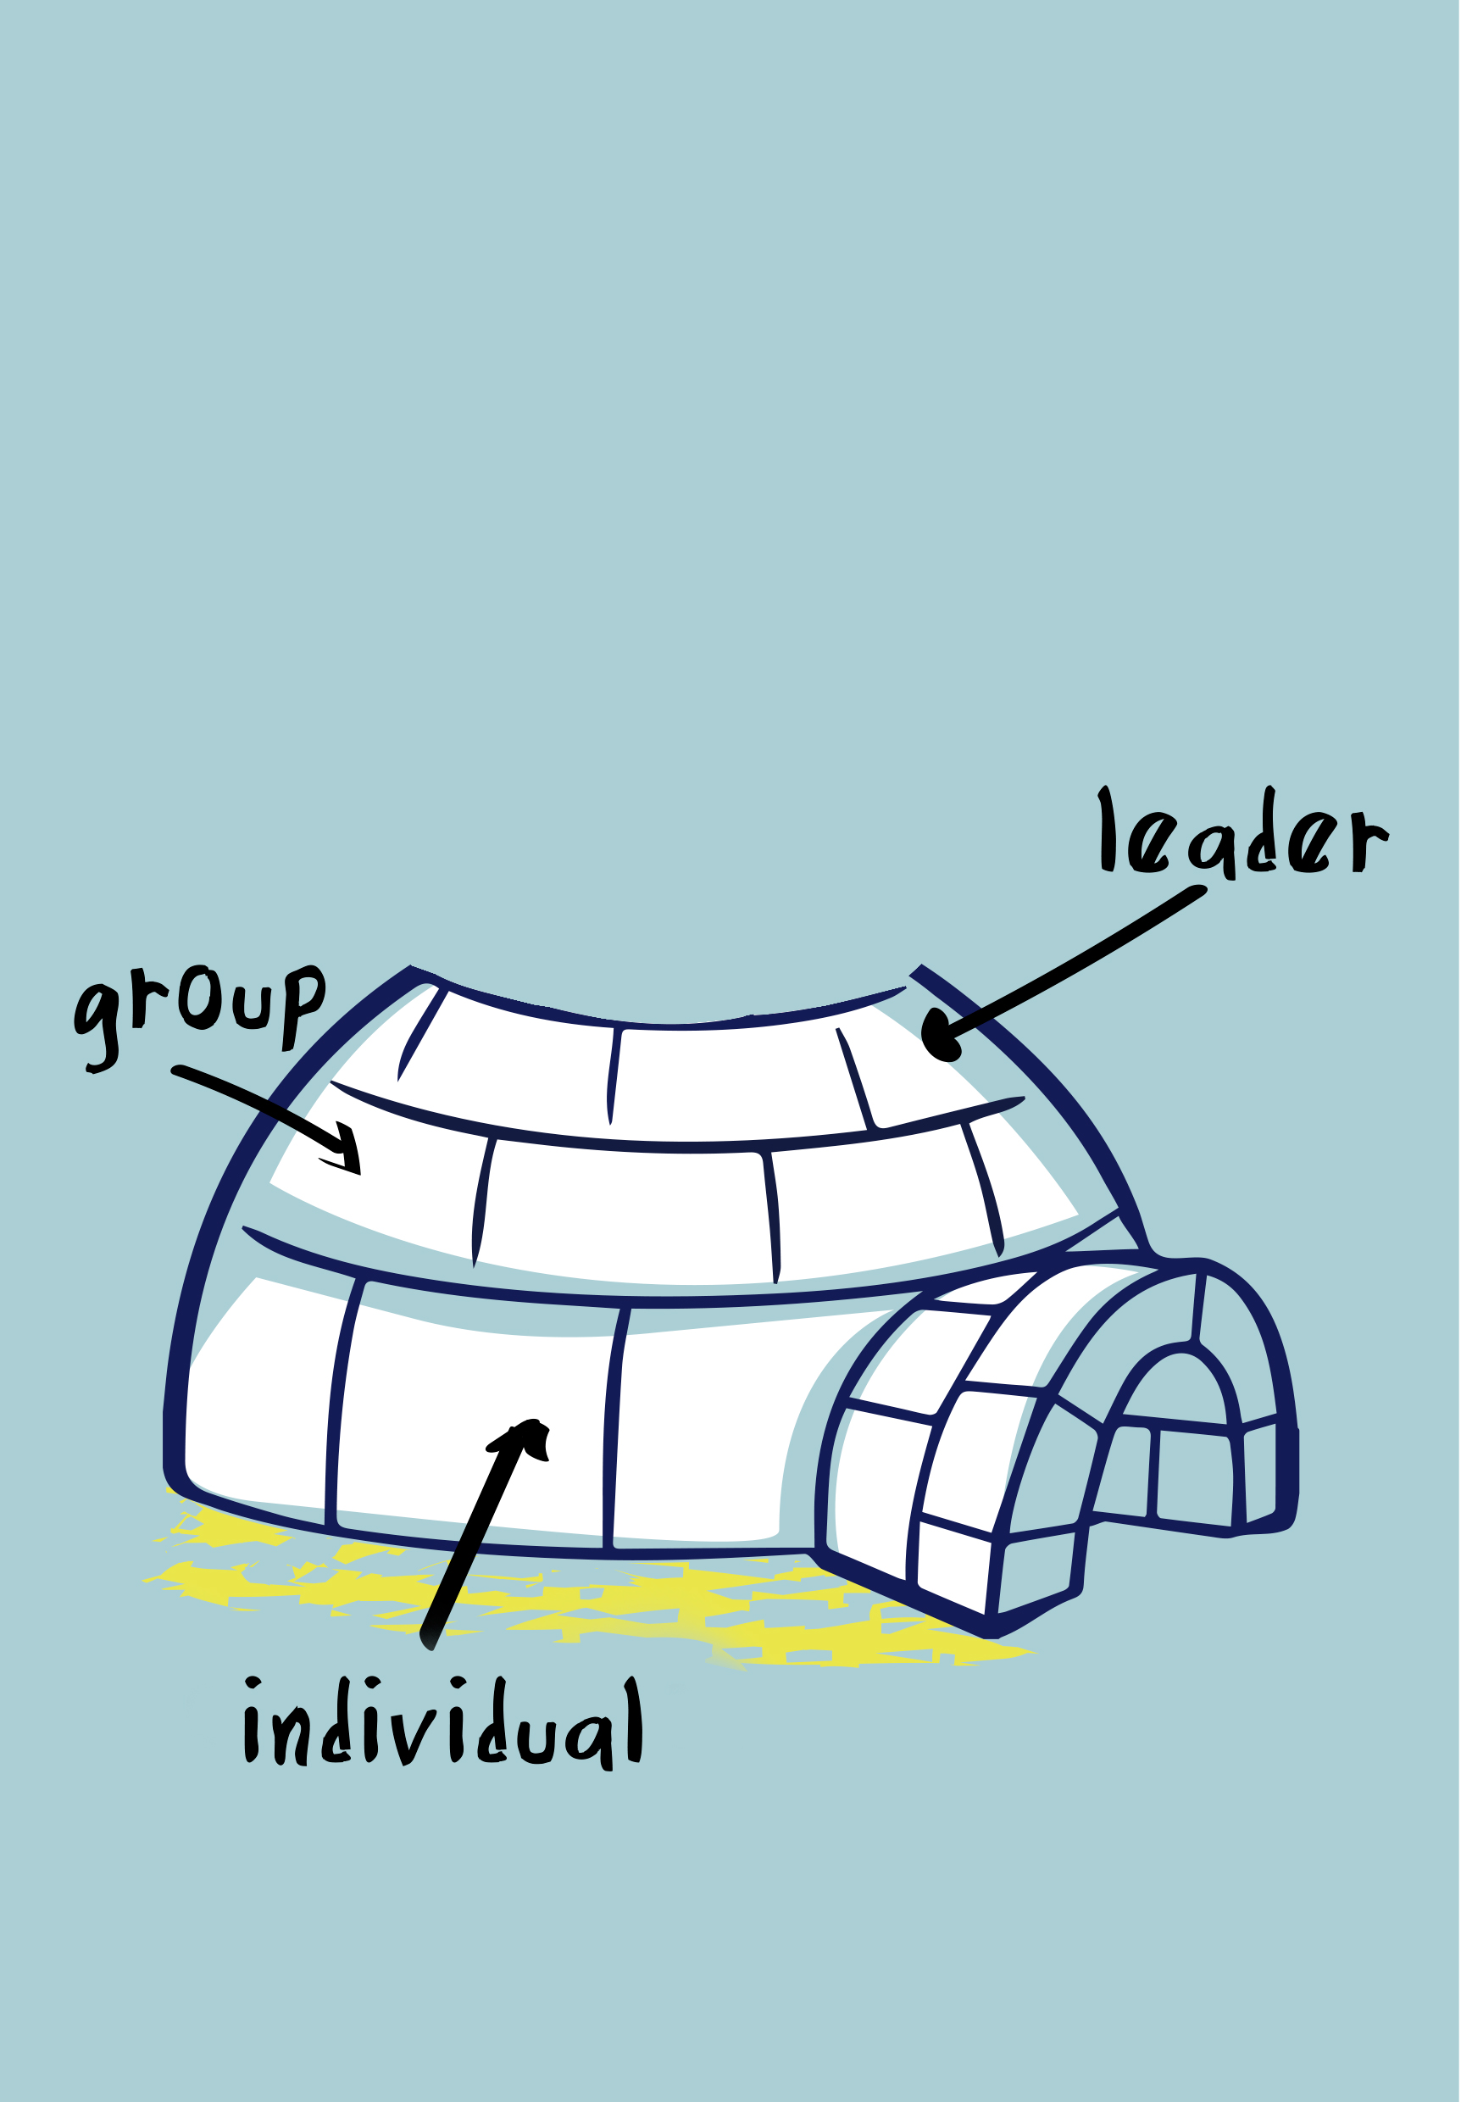
Line manager level
Work
Extending the phased return period (6mths +)
Adjusting tasks e.g. removing cognitively and physically taxing tasks
Providing opportunities to work from home
Providing opportunities to work flexible hours
Taking an individualised approach, flexing work adjustments on a test and learn basis
Non-work
***** Absence of links to services for many*****
Dr Joanna Yarker | E: jo@affinityhealthatwork.com | www.affinityhealthatwork.co.uk

Slide 16
Organisational level
Work
Providing flexible working practices and leave policies
Establishing a culture where mental health and physical health are prioritised
Reviewing absence management policies to avoid punitive systems for fluctuating conditions
Non-work
Access to health and wellbeing advice and support
Contacting charities (e.g. The Firefighters Charity, Mind, Samaritans)
…..
Dr Joanna Yarker | E: jo@affinityhealthatwork.com | www.affinityhealthatwork.co.uk

Slide 17
What can be done outside the Organisation?
Helping others – advocacy and support
Government policies and information – trusted sources of information
Media – to build awareness of long Covid
Unions – to advocate and provide advice
Online support groups
Dr Joanna Yarker | E: jo@affinityhealthatwork.com | www.affinityhealthatwork.co.uk

Slide 18
Implications for research, policy and practice
Everyone has a role to play: Returning individuals, groups, line managers, organisational professionals.
Need to increase knowledge, skills and confidence in supporting people to return to and stay at work when managing long term conditions.
We need research to help us understand what works, for whom, under what circumstances.
JOIN OUR ROUNDTABLE DISCUSSIONS
Let us know what has worked, and what has not, when it has come to supporting your employees with long Covid.
Jo Yarker, Affinity Health at Work - jo@affinityhealthatwork.com
Rachel Suff, CIPD - r.suff@cipd.co.uk
Dr Joanna Yarker | E: jo@affinityhealthatwork.com | www.affinityhealthatwork.co.uk

Slide 19

Workers with Long Covid: 'Experts By Experience'
Lesley Macniven MA, CIPD Fellow
Writer, Coach & OD Consultant
Employment Group Chair, Long Covid Support
@lesleymacniven
#LongCovidWork
https://www.linkedin.com/in/lesley-macniven-b8a82b45/
27 September 2021
Notes:
My intro
Thanks so much to the CIPD for the invitation to speak today to fellow business / HR & occupational professionals on the thorny subject of Long Covid and how we respond to its effects.
To illustrate this theme of multidisciplinary working, for the next hour I will be wearing several hats:
- as a person living with the lingering effects of a Covid19 infection in March 2020
- a campaigner for rehab, research and recognition since May 2020
- a business professional with 20 years experience in strategic HR, organisational development and behaviour-led change management
One of the highly skilled, motivated and collaborative team members behind Long Covid Support.
I’ll share more about campaigning tour de force Long Covid Support in this presentation. But the most relevant aspect, to start with, is our Employment agenda.
As chair of our Employment working group I lead a multidisciplinary team of professionals who I’d have loved to have brought along today, but we have to pace!
So, whilst I represent the group, we can also run follow up sessions on specific aspects of the problem and solutions, from OT to unconscious bias leading to discrimination.
We’ve effectively formed an inter-disciplinary consultancy as we truly believe the complexity and prevalence of this ‘problem’ this illness affecting so many in our workforce, can only truly be addressed by taking a systems based approach. The current lack of progress we could argue is a failure to address issues in a systematic way and to address systemic barriers to innovating more helpful responses.
Nothing makes me happier than delving into organisational development models and theories of change but that is the background to today’s session, not the main event. The focus is how this approach can support an occupational health response.

Slide 20
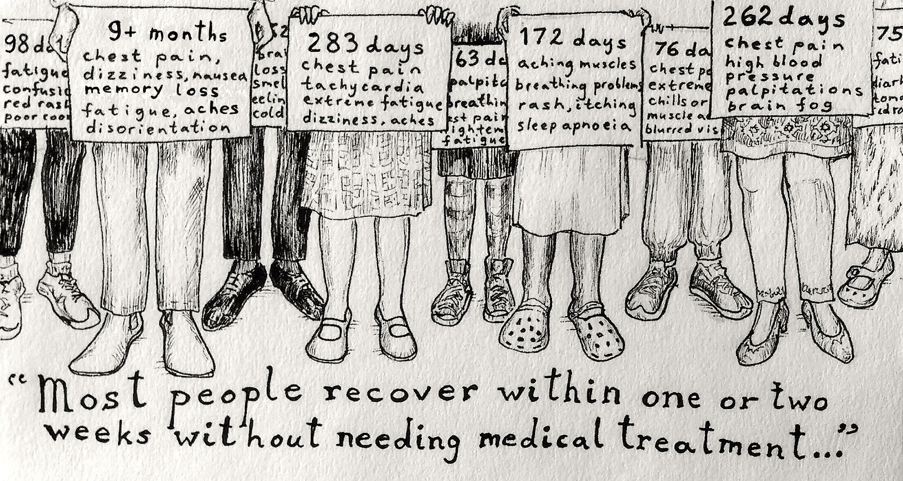
https://www.facebook.com/DormouseDiaries/
Notes:
The blog I wrote for the Society of Occupational Medicine ahead of their Long Covid Summit in March this year showed how those living with the worst affects of the pandemic right now are those in the first wave
This is why we are asking for LV to be seen as an occupational disease

Slide 21
Overview
People experiencing debilitating symptoms months after infection with SARS-CoV-2 need investigations, treatment and rehabilitation, as well as support returning to work or education. Many people experience stigma and discrimination, and difficulties accessing appropriate healthcare and support.
“At least I know I'm not alone. And I think people who actually have had the disease tend to know a little bit more about it.
I actually think that the support group has given more knowledge than the doctors have.” ¹
Ladds, E., Rushforth, A., Wieringa, S. et al. Persistent symptoms after Covid-19: qualitative study of 114 “long Covid” patients and draft quality principles for services. BMC Health Serv Res 20, 1144 (2020). https://doi.org/10.1186/s12913-020-06001-y Dec 20th 2020
Long Covid Support is a Company Limited by Guarantee
Registered Company Number (England and Wales) 13422248
Notes:
Our approach is holistic
Solutions need to be multidisciplinary

Slide 22

Occupational Health. Definition :
Occupational Health is the promotion and maintenance of physical, mental and social well-being of workers in all occupations by preventing departures from health, controlling risks and the adaptation of work to people, and people to their jobs.
LongCovid.org
@long_covid
22
Notes:
So the focus for today is the area of occupational health.
First we need a definition we can work with.
How do we work post-pandemic?
What is the same as before? What has changed?
We’ve had to adapt work to people having to isolate, work from home etc to prevent health impacts and control risks of infection, illness and chronic ill health.
Death isn’t the only risk that needs managed.
Behaviour-led change management means you start with people.
At each point we could ask the question, are we adapting work to people where they are now, or are we wanting people to adapt to their pre-pandemic job role (and is that actually necessary?
Example:

Slide 23
NIHR EVIDENCE: LONG COVID
Long Covid can be very debilitating and some people need help with personal care months after the initial infection.
71% of respondents in our own survey said Long Covid was affecting family life and 39% said it was impacting their ability to care for dependents.
This is having an impact on the workforce, with 80% of respondents in our own survey saying Long Covid had affected their ability to work and 36% said it was affecting their finance.
https://evidence.nihr.ac.uk/themedreview/living-with-covid19-second-review/
Notes:
https://evidence.nihr.ac.uk/themedreview/living-with-covid19-second-review/
Unusually for many chronic illness (or what we tend to think of as how chronic illness manifests, a vast majority of people affected come from the working population.
Current HR Challenge
As we hear daily of skills shortages the lack of rehabilitation of key workers with Long Covid is a part of that story. We know many doctors, nurses, pharmacists, OTs and frontline workers in teaching, logistics & retail trying and failing to find a way back.
Often the issues are:
*rigidly sticking to policies written pre=pandemic,
*a lack of medical assessment,
*poor or non-existent communication while ‘off sick’ regarding reasonable adjustments and how to stay engaged with the team
*inflexible approaches for phased returns - repeated failed attempts needlessly destroys hope
Whether I advocate for coaching as a management style or the ability for most workers to learn and develop, there will be exceptions. The longer time goes on the more concerning it is that people will struggle to return.
This sees those who got ill when frankly our leaders were flailing about not sure what to do, have drawn the shortest of straws. But have equally shown the greatest resilience and been the informed and motivated founders of this patient movement for rehab, research and recognition. I am stunned at the quality of people I’ve been working with these last 18 months and what we have achieved, while masterminding our own recoveries, homeschooling and in some cases caring for kids with Long covid themselves - something we will see more of, parents being affected as carers for a chronically ill child.
Health is being pitted against the economy when it comes to decision making. But our argument is always that first and foremost our economy needs a healthy workforce, in terms of individual and overall strength.
And, sadly, stigma, exclusion and disbelief.
As a diversity and inclusion consultant pre-pandemic I know how hard it is to recruit hard to reach talent and organisations are going to have their work cut out trying to create diverse workforces if we don’t take action to stem the loss of so much talent that was hard to find and rerecruit pre-pandemic.

Slide 24
Who we are
Long Covid Support (https://www.longcovid.org/) is an international peer support and advocacy group for people with Long Covid
We comprise a core group of 40-50 people with Long Covid working across numerous work streams including advocacy, support, research involvement and campaigning
Long Covid Support was formed by a group of people struggling to recover from Covid-19, who found each other online and have been campaigning in the UK for recognition, rehabilitation and research into treatments since May 2020
We provide online support for over 44,000 members in 100 countries/territories and advocate for people with Long Covid across the U.K
Working groups include our Employment and Welfare Rights team
LongCovid.org
24
Notes:
I’m on the steering group

Slide 25
Our purpose is to support people with Long Covid.
“Our findings suggest that the various online patient support groups for long Covid have earnt a place at the table when designing services and planning new research. Whilst such groups are not new, and may sometimes grow to a membership of thousands and provide a source of patient-generated data for researchers, the long Covid peer support groups on Facebook and Slack have taken the lead in generating the evidence base on long Covid, sharing practical advice, filling gaps in the formal support system, and campaigning for better and more consistent services.”"
Ladds, E., Rushforth, A., Wieringa, S. et al. Persistent symptoms after Covid-19: qualitative study of 114 “long Covid” patients and draft quality principles for services. BMC Health Serv Res 20, 1144 (2020). https://doi.org/10.1186/s12913-020-06001-y Dec 20th 2020
LongCovid.org
25
Notes:
The reason we exist is that Long Covid hasn’t been well managed

Slide 26
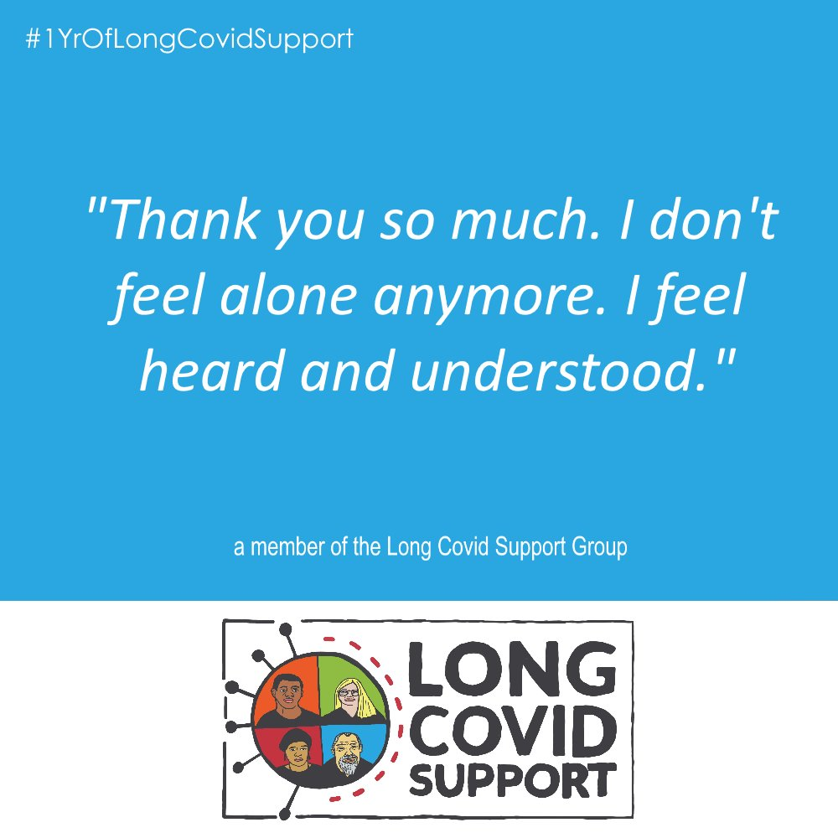
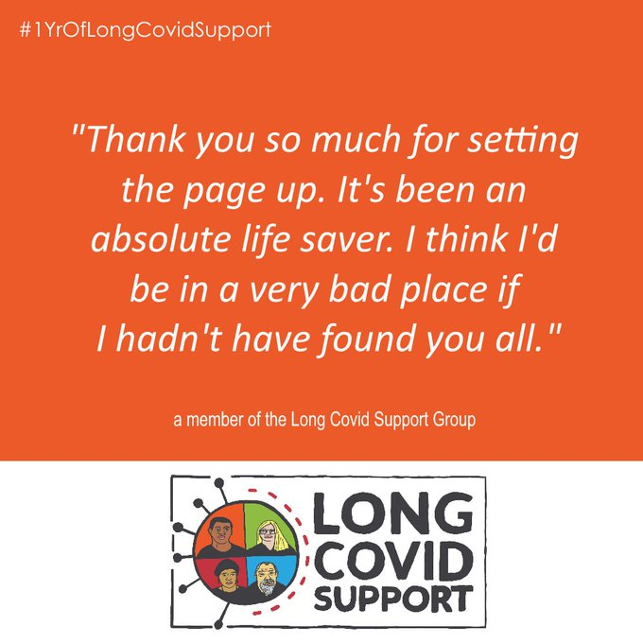
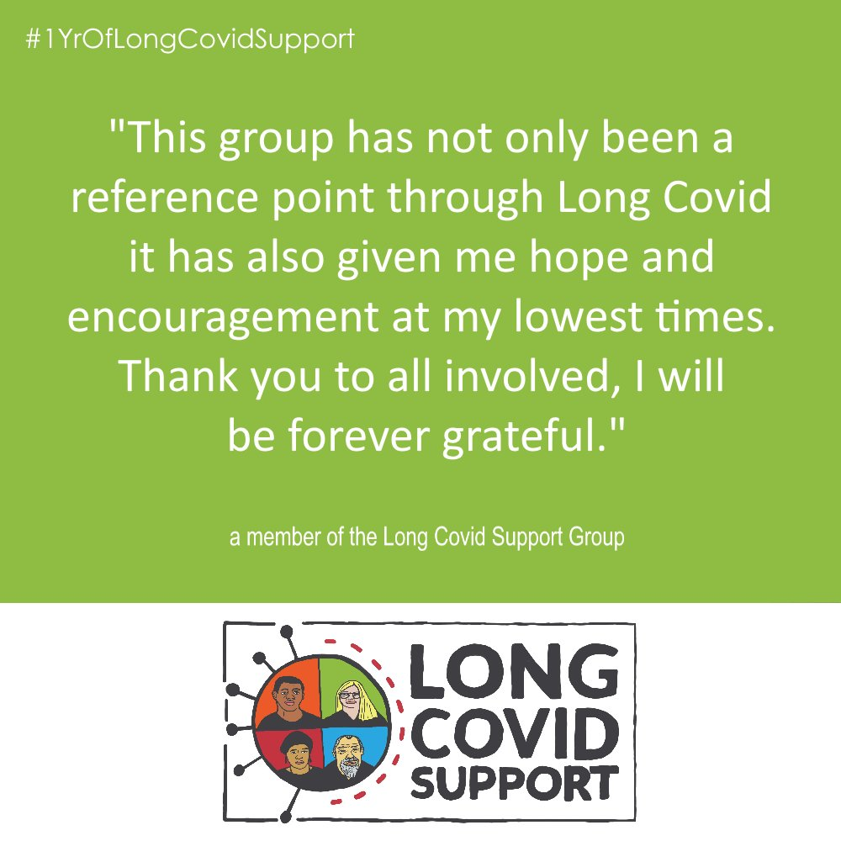
For many this has literally been a lifeline.
LongCovid.org
26
Notes:
How can this focus on wellbeing at work being extended to the workplace?

Slide 27
Our Values
Peer-led: Warm, genuine, compassionate, empathetic and approachable
Inclusive: Diverse, equity-oriented and open-minded
Expert: Professional, fact-based, evidence-informed and knowledgeable
Driven: Motivated, tenacious, passionate and determined
Collaborative: People-centred, partner-oriented, open, fair and holistic
Dependable: Trustworthy, safe and respected
LongCovid.org
27
Notes:
What aspects of these are present in your Organisation, HR & management culture?

Slide 28
LEADING IN A CHANGING WORLD:
How can OD (& OH) practitioners step up to our post-pandemic challenges?
“Those who work in the world of OD know the discipline is complex and varied”.
OD practitioners’ remits include: recruitment, diversity, learning, talent, reward and internal communication.
“An OD practitioner should take a systems approach, consider all the knock-on factors in their work to make the most impact. Each of the component parts of OD will be affected in a range of ways.
In most workplaces, OD has seen a number of significant changes due to COVID-19. The ways in which we attract, retain, develop and engage the workforce have shifted, with the events of 2020 being the tipping point.
Transitioning to new ways of working will require careful management and leadership. The right balance needs to be struck between using in-house, interim and contract labour. OD practitioners with experience in culture and behaviour change will find themselves a sought-after resource.”
https://www.cipd.co.uk/knowledge/strategy/organisational-development/thought-pieces/leading-changing-world
Notes:
https://www.cipd.co.uk/knowledge/strategy/organisational-development/thought-pieces/leading-changing-world

Slide 29
NIHR EVIDENCE: LONG COVID
Whilst there is a growing list of symptoms associated with Long Covid, we know little about different clusters and patterns of symptoms (sometimes described as phenotypes, syndromes or clusters).
There is increasing evidence of organ impairment in both people who were admitted to hospital and those who stayed at home.
The limited evidence of correlation between past history and current pathology would suggest a need to investigate anyone with persistent symptoms, including those who were never admitted to hospital.
https://evidence.nihr.ac.uk/themedreview/living-with-covid19-second-review/
Notes:
https://evidence.nihr.ac.uk/themedreview/living-with-covid19-second-review/
Individual approach needed

Slide 30
You don’t have to do everything well. At the Olympics, if you run the 100 metres well, you don’t have to do the shot putt…” — Warren Buffett
LongCovid.org
@long_covid
30
Notes:
Organisations are made up of teams. Roles can become fixed. We need agility. Not speed of doing but athletes work with coaches, with precise training regimes, most of the effort leads up to the visible 10 second sprint. But the competitive advantage also comes off the track in unleashing potential.
We need agility. Not speed of doing but athletes work with coaches, with precise training regimes, most of the effort leads up to the visible 10 second sprint. But the competitive advantage also comes off the track in unleashing potential. Through leadership.
We have a lot of leaders in the room today.
In Long Covid Support we’ve moved around, we’ve found our fit. In my 30 year career I did the same. (Please never make me go back to Internal Audit.)
Focus on what can this person do?
How can we release their potential?
Take a coaching rather than an expert approach
In Long Covid Support we’ve moved around, we’ve found our fit. In my 30 year career I did the same. (Please never make me go back to Internal Audit.)
Focus on what can this person do?
How can we release their potential?
Take a coaching rather than an expert approach

Slide 31
Our Vision
For Long Covid to be well defined and understood, with high quality information, support and health services in place throughout the UK
For patients to be equal partners in all decisions about their health and welfare and to have equitable access to investigations, diagnosis, treatment and rehabilitation
That a broad range of individuals and communities - within and beyond the UK - connect for support, to share information and perspectives, and have their rights and needs heard by decision makers
LongCovid.org
31

Slide 32
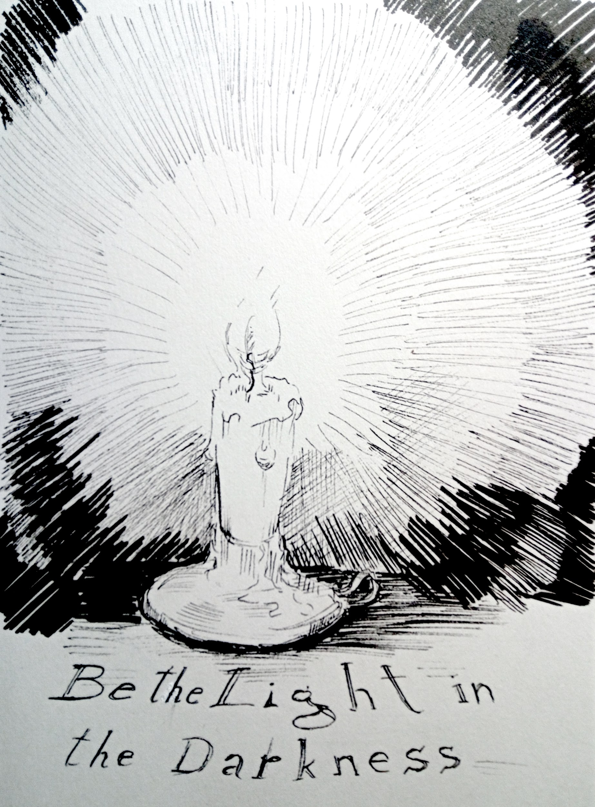
https://www.facebook.com/DormouseDiaries/
Notes:
We need forward thinking employers to seize the challenge and work with us.
We’re always looking for the positive case studies to show how what we advocate can be achieved.
How you interact with people with long covid will either bring some light into their lives or can seriously worsen an already difficult situation.

Slide 33
DIVERSITY & INCLUSION
How do you ensure diversity and inclusion in the workplace?
Six practical strategies for creating an inclusive environment:
Create a D & I Strategy & Taskforce
Educate Your Leaders
Consciously celebrate Employee Differences
Listen to Employees
Hold More Effective Meetings
Communicate Goals and Measure Progress
https://www.cipd.co.uk/knowledge/fundamentals/relations/diversity/factsheet#gref
Notes:
https://evidence.nihr.ac.uk/themedreview/living-with-covid19-second-review/
How is your D & I practice
Not just about Long Covid, though there are challenges due to lack of understanding

Slide 34



Find us
LongCovid.org
Long Covid Support Group https://www.facebook.com/groups/longcovid
@long_covid
@longcovid
Notes:
Employment group

Slide 35
Questions
Please submit your questions for:
  Rachel Suff, Senior Employee Relations Adviser, CIPD
  Steve Boorman, Director of Employee Health, Empactis
  Dr Jo Yarker, Chartered Occupational Psychologist and Senior Lecture, Birbeck University of London
  Lesley Macniven, Chair of UK Long COVID Support Employment Working Group
  Matt Reymes-Cole, Legal Manager, Croner
Please use the Q&A function to submit your questions

Slide 36
#StrongerWithCIPD
Covid-19 resources
NEW Well-being helpline
Employment Law helpline
Communities and branches
People Management
Knowledge and content
Free learning
Careers support
Professional creditability
Financial support
cipd.co.uk/memberbenefits

